Slide 1
VLSI Design
ECE 361
Spring 2012
Room No. A5-317

Slide 2
General System
Transmitter
Transmission
Receiver

Slide 3
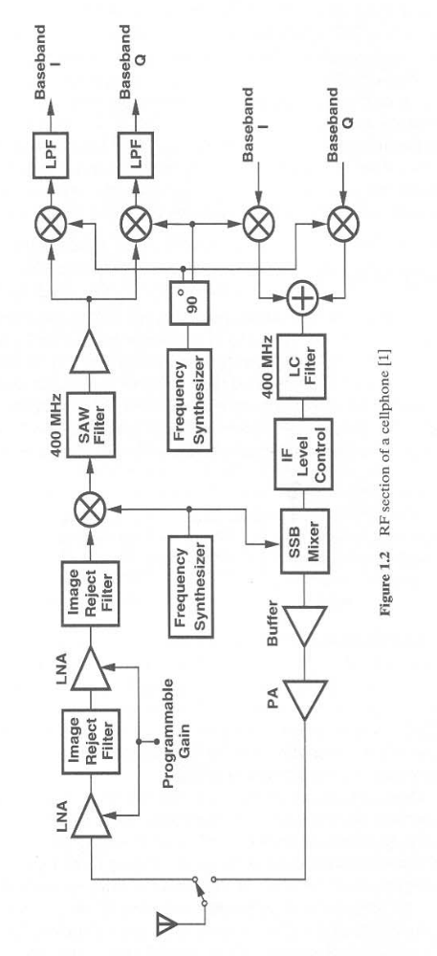
RF Section
Picture taken from RF Microelectronics by Razavi

Slide 4
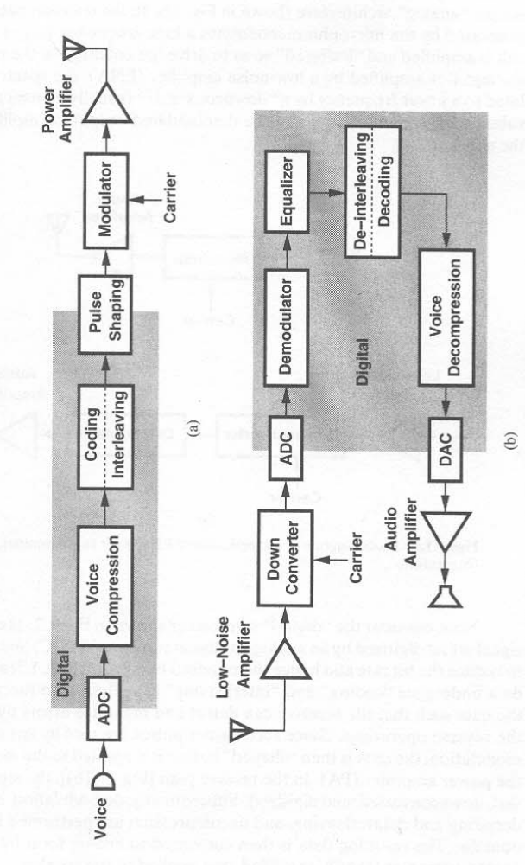
Digital Tx and Rx
Picture taken from RF Microelectronics by Razavi

Slide 5
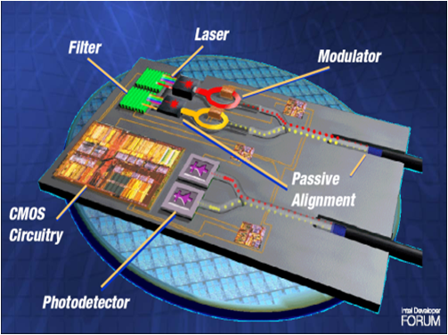
Typical design
Picture taken from College of Optics & Photonics, UCF

Slide 6
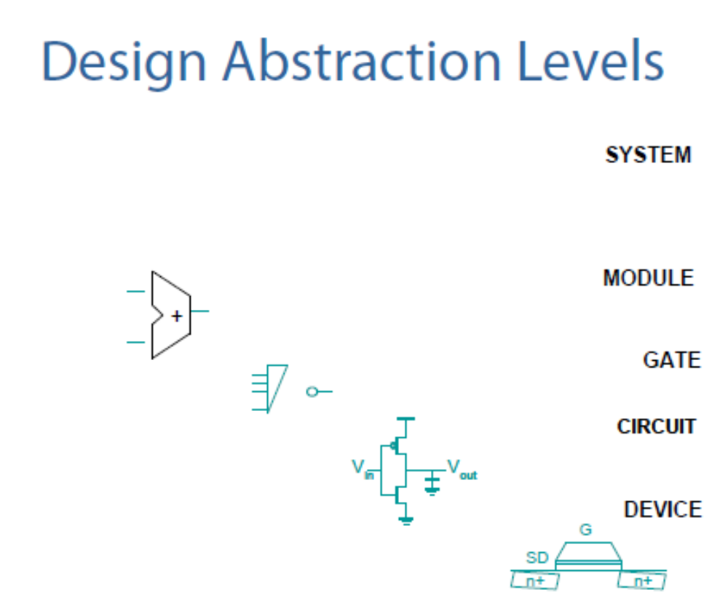
Hierarchy

Slide 7
Where is VLSI
Exponential growth in complexity
Digital, Analog, RF, Optical, MEMS
Computers everywhere
Wireless, portable, low power
Moore’s Law

